Slide 1
COVID-19 Vaccine Education
Helping you make an informed decision
Presented by the South East Infection Prevention and Control Hub and Kingston Health Sciences Centre
Adapted from Sunnybrook Health Sciences Centre COVID-19 Vaccine Education
SE IPAC Hub assumes no liability resulting from any such application or use. This document may be reproduced without permission for non-commercial purposes only and provided that appropriate credit is given to SE IPAC Hub. No changes and/ or modifications may be made to this document without express written permission from the SE IPAC Hub. Contact SEHubintake@kingstonhsc.ca to request permission.
Notes:
The SE Regional IPAC Hub is committed to improving infection prevention and control practices in all congregate settings within the SE Region, this includes conversations and education around COVID-19 vaccination. This education module was reviewed by a panel of local experts and partners who support the use of this module for education.
In addition to Public Health measures that may be in place and healthy habits to help limit transmission, the COVID-19 vaccine is the most effective way to prevent COVID-19 infection.

Slide 2

Purpose of COVID-19 learning module
To provide you accurate information on:
  COVID-19
  COVID-19 vaccinations
To help you make an informed decision!
If you have been fully vaccinated or have a medical exemption you may not be required to complete this learning module; however, the information provided will still be beneficial and informative.
If you are unsure or have decided not to be vaccinated this learning module must be completed to ensure you are making an informed decision.
Notes:
This module will provide you standardized education with the most accurate and up to date information you need to make an informed decision regarding COVID-19 vaccination.
This learning module was created in response to the Ministers Directive requiring LTCH to develop a COVID-19 vaccination policy including a COVID-19 vaccination education program. Recently Ontario’s chief medical officer health has implemented Directive #6 requiring COVID-19 vaccination policies for hospitals, home & community services, local health integration networks and ambulance services. Additional high risk settings will be required to implement similar policies in the near future.
This education module/presentation will be useful for anyone who has questions around COVID-19 vaccinations. If you have been fully vaccinated or have a medical exemption you may not be required to complete this learning module; however, the information provided will still be beneficial and informative. If you are unsure or have decided not to be vaccinated this learning module must be completed to ensure you are making an informed decision.
COVID-19 vaccination, like all vaccines, helps to keep us, our families, friends, coworkers, residents, patients, clients and our community safe.

Slide 3
Learning Objectives
What is COVID-19?
What are the benefits and risks of COVID-19 vaccination and do they work?
What are the types of COVID-19 vaccines available and how do they work?
Are COVID-19 vaccines safe?
What are the common side effects of COVID-19 vaccines?
What can I expect before, during, and after immunization?
Notes:
*Updated August 18th, 2021 using the sources provided
Source:
Minister's Directive: https://www.ontario.ca/page/ministers-directive-long-term-care-home-covid-19-immunization-policy
Minister Directive for COVID-19 Vaccine Education requirements:
Proof that the individual has completed an educational program approved by the licensee that addresses, at a minimum, all of the following:
How COVID-19 vaccines work
Vaccine safety related to the development of the COVID-19 vaccines
The benefits of vaccination against COVID-19
Risks of not being vaccinated against COVID-19
Possible side effects of COVID-19 vaccination
Directive #6 https://www.health.gov.on.ca/en/pro/programs/publichealth/coronavirus/docs/directives/vaccination_policy_in_health_settings.pdf
Proof of completing an educational session approved by the Covered Organization about the benefits of COVID-19 vaccination prior to declining vaccination for any reason other than a medical reason. The approved session must, at minimum address:
how COVID-19 vaccines work;
vaccine safety related to the development of the COVID-19 vaccines;
the benefits of vaccination against COVID-19;
risks of not being vaccinated against COVID-19; and
possible side effects of COVID-19 vaccination.

Slide 4
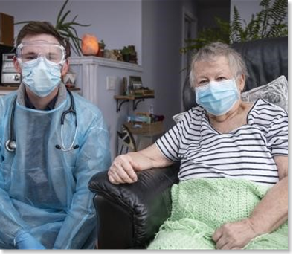
COVID-19 Pandemic Impact – August 2021
Infection Rate | Death Rate | Societal Impacts
209 million infections worldwide and counting Click here to see COVID-19 infection map Ontario: 556,438 cases Ontario COVID-19 Data Local Health Unit COVID Data: Public Heath Regions | Nearly 5 million deaths worldwide Nearing 10,000 in Ontario Variants of Concern (VOC) 4 times higher risk of ICU admission 2 times the risk of death Case-fatality rate is 8-10x higher than seasonal influenza | Straining our health care system Delay in surgeries and treatments Increased hospital capacity Restrictions on daily life
Notes:
*Statistical information updated August 18th, 2021 using the source provided
Source:
https://www.cdc.gov/coronavirus/2019-ncov/long-term-effects.html
https://coronavirus.jhu.edu/map.html
Sunnybrook Health Sciences COVID-19 vaccine education module https://360.articulate.com/review/content/e77b56e0-45ed-42d0-9d9f-1b51eb8277ed/review
https://covid-19.ontario.ca/data
To date over 209 million people have been infected with COVID-19 with nearly 5 million deaths making COVID-19, a now vaccine preventable disease, among the leading causes of death globally. In Ontario almost 600,000 people have been infected and we are approaching 10,000 COVID-19 deaths. To see real time global information visit the Johns Hopkins University COVID-19 dashboard : COVID-19 Map - Johns Hopkins Coronavirus Resource Center (jhu.edu) or links to your public health region
COVID-19 does not just impact older people. As older individuals get vaccinated and with the highly transmissible COVID-19 variants of concern on the rise the demographic of those impacted by COVID-19 is now younger adults and children, some who are ending up in intensive care requiring life supporting interventions. The COVID-19 death rate is 8-10 times higher than with seasonal influenza. The variants of concern lead to a 4 times higher increase risk of ICU admission and double your risk of death. We can’t predict who may experience the most serious complications or long term post COVID conditions.
Even after recovery from COVID-19 post-COVID conditions pose a wide range of new, returning, or ongoing health problems people can experience more than four weeks after first being infected. We are seeing struggles with memory, difficulty thinking or concentrating, fatigue, body aches, heart and lung damage that are lasting for weeks to months and can happen to anyone who has had COVID-19, even if the illness was mild or they had no symptoms.
Like any disease, especially COVID-19 which we are trying to control, we see a strain on our health care system with delays in surgeries and hospitals operating at or above capacity – not to mention the public health measures put in place to help limit transmission that impacts our daily lives.
Everyone who gets COVID-19 gets it from someone else. If you get it, you may be fortunate and have a mild case. But what may be minor for you could be devastating for someone you pass it on to.

Slide 5
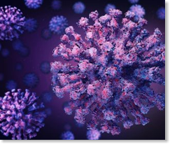
What is COVID-19?
SARS-CoV-2 coronavirus
First identified in Wuhan China-2019
Causes respiratory illness ranging from mild common cold symptoms to severe pneumonia
May cause severe illness, long-term post-COVID conditions, and death
Impacts individuals, their community, and our health care system
Affects people of all ages
Notes:
Source:
https://www.cdc.gov/coronavirus/2019-ncov/faq.html#Basics
https://www.publichealthontario.ca/en/diseases-and-conditions/infectious-diseases/respiratory-diseases/novel-coronavirus/about-covid-19
COVID-19 is a disease caused by a virus called SARS-CoV-2 virus that was first recognized in 2019. Most people with COVID-19 have mild symptoms, but some people can become severely ill and require Intensive Care and life supporting interventions.
Although most people with COVID-19 get better within weeks of illness, some people experience post-COVID conditions or complications. These include a wide range of new, returning, or ongoing health problems people may experience more than four weeks after first being infected with the virus that causes COVID-19.
Generally older people and those who have certain underlying medical conditions are more likely to get severely ill from COVID-19, although individuals of all ages are at risk of severe illness and experiencing long-term post COVID health conditions.

Slide 6
What are variants of concern?
Variants are SARS-CoV-2 viruses that have changed or “mutated”
COVID-19 viruses become a “variant of concern” or “VOC” when its changes have a clinical or public health significance that affects one or more of:
  Increased transmissibility (spread)
  Increased virulence (severity of disease)
  Decreased vaccine effectiveness
  Impact on diagnostic testing
There are currently 4 variants of COVID-19 that are a concern to public health. They are commonly referred to as the Alpha, Beta, Gamma and Delta variants, respectively.
Delta is now the most dominant strain, accounting for more than 90% of all new COVID-19 cases in Ontario
Each time the virus is transmitted from person-to-person the virus can change, leading to mutation in the virus and variants of concern
Notes:
*Statistical information updated August 18th, 2021 using the source provided
Source:
https://www.publichealthontario.ca/en/diseases-and-conditions/infectious-diseases/respiratory-diseases/novel-coronavirus/variants
https://www.publichealthontario.ca/-/media/documents/ncov/epi/covid-19-sars-cov2-whole-genome-sequencing-epi-summary.pdf?sc_lang=en
Variants are viruses that have changed or mutated – and is expected to happen. Variants are common with all coronaviruses; however, a variant becomes a VOC when its changes have a clinical or public health significance that affects one or more of the following:
transmissibility or how easily the virus can be spread
virulence or the severity of the COVID-19 infection
vaccine effectiveness or how well the vaccine prevents illness
diagnostic testing such as the ability to test or surveil for infection
There are currently 4 variants of COVID-19 that are a concern to public health. They are commonly referred to as the Alpha, Beta, Gamma and Delta variants, respectively.
Delta is now the most dominant strain, accounting for more than 90% of all new COVID-19 cases in Ontario
Studies are ongoing to determine the effectiveness of the currently authorized vaccines against these variants. But research is promising, most vaccines are proving to be effective against emerging variants; especially when people are fully vaccinated. Its important to remember that no vaccine is 100% effective.

Slide 7
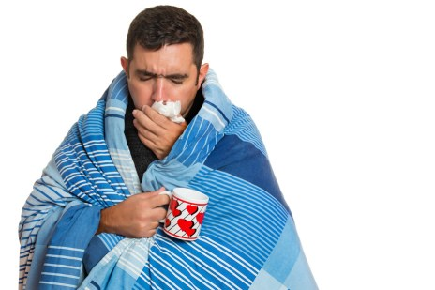
Signs and Symptoms of COVID-19
Most common
Less common
Fever
New cough or worsening chronic cough
Shortness of breath or difficulty breathing
Tiredness or weakness
Sore throat
Runny nose or nasal congestion
Headache or dizziness
Loss of taste or smell
Conjunctivitis
Gastrointestinal symptoms (abdominal pain, diarrhea, vomiting)
Skin changes or rashes
Remember: If you have these symptoms you should self isolate and be tested for COVID-19 and potentially other respiratory pathogens.
Notes:
Source:
https://www.who.int/emergencies/diseases/novel-coronavirus-2019/question-and-answers-hub/q-a-detail/coronavirus-disease-covid-19#:~:text=symptoms
https://www.canada.ca/en/public-health/services/diseases/2019-novel-coronavirus-infection/symptoms.html
https://www.publichealthontario.ca/en/diseases-and-conditions/infectious-diseases/respiratory-diseases/novel-coronavirus/about-covid-19
Symptoms of COVID-19 can vary from person to person. They may also vary in different age groups. The most common symptoms are: a fever, dry cough – either new or worsening chronic cough, shortness of breath/difficulty breathing, tiredness or weakness.
Other symptoms that are less common but may affect some people include: sore throat, runny nose, nasal congestion, headache or dizziness, Loss of taste or smell, conjunctivitis (or eye redness), gastrointestinal symptoms such as abdominal pain, diarrhea or vomiting; and different types of skin rashes. Children tend to have more abdominal symptoms and skin changes or rashes.
Symptoms may take up to 14 days to appear after an exposure to COVID-19.
Remember: If you have these symptoms you should self-isolate and be tested for COVID-19 and potentially other respiratory pathogens.

Slide 8
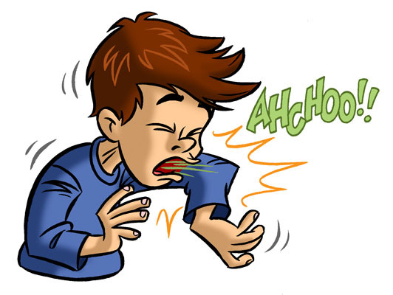
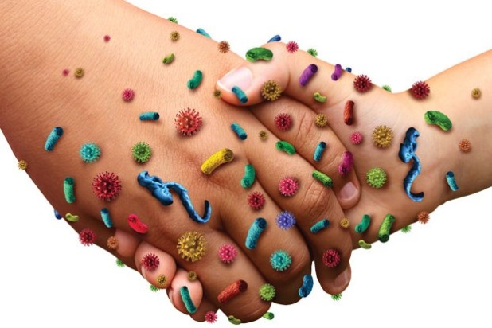
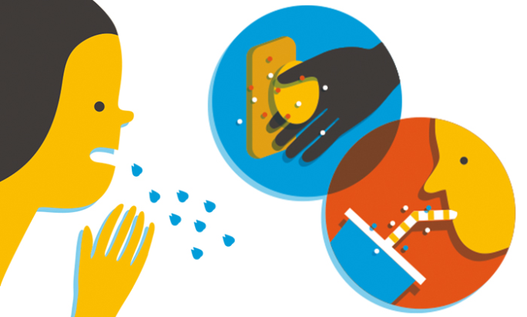
How is COVID-19 Spread?
Person-to-person transmission:
Direct contact-droplets and short-range aerosols from coughing or sneezing when people are within 2m of each other
In-direct contact-touching an object or surface that has been contaminated and then touching your mouth, nose or eyes with unclean hands
Respiratory Droplets
Direct Contact
Indirect Contact
Notes:
Source:
https://www.canada.ca/en/public-health/services/diseases/2019-novel-coronavirus-infection/health-professionals/main-modes-transmission.html
https://www.cdc.gov/coronavirus/2019-ncov/faq.html#Spread
https://www.publichealthontario.ca/-/media/documents/ncov/covid-wwksf/2021/05/wwksf-transmission-respiratory-aerosols.pdf?la=en
SARS-CoV-2, the virus that causes COVID-19, is transmitted or spread most frequently and easily at short range from an infected person to others through respiratory particles when an infected person coughs, sneezes, sings, shouts, or talks - mainly through close contact from people who are physically near each other, generally within 2m. The respiratory particles vary in size and can be large droplets that fall to the ground rapidly (within seconds or minutes) near the infected person, to smaller droplets, sometimes called aerosols, which linger in the air under specific circumstances such as aerosol generating medical procedures.
COVID-19 spreads very easily from person to person. How easily a virus spreads can vary. The virus that causes COVID-19 appears to spread more efficiently than influenza but not as efficiently as measles, which is among the most contagious viruses known to affect people.
Infectious droplets or aerosols may come into direct contact with the mucous membranes of another person's nose, mouth or eyes, or they may be inhaled into their nose, mouth, airways and lungs. The virus may also spread when a person touches another person (e.g., a handshake) or a surface or an object, such as a railing or door handle, which has the virus on it, and then touches their mouth, nose or eyes with unwashed hands.
We know that the virus is most frequently transmitted when people are in close contact with others who are infected with the virus (either with or without symptoms). We also know that most transmission occurs indoors and in poorly ventilated spaces.
Research around COVID-19 transmission is ongoing. There is no evidence at this time that the virus is able to transmit over long distances through the air, for example, from room to room through air ducts. It is still unclear how easily the virus spreads through contact with surfaces or objects.

Slide 9
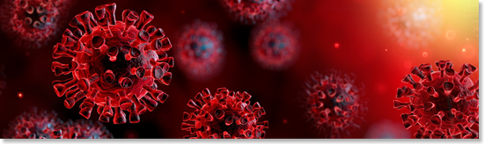
How soon after I’m exposed do I get sick?
Incubation Period = up to 14 days
  Average=5-6 days
  Most common=within 11.5 days
Notes:
Source:
https://www.canada.ca/en/public-health/services/diseases/2019-novel-coronavirus-infection/health-professionals/transmission.html
https://www.publichealthontario.ca/-/media/documents/ncov/covid-wwksf/2021/03/wwksf-period-of-communicability-overview.pdf?la=en#:~:text=%E2%80%9CWhat%20We%20Know%20So%20Far,issue%20related%20to%20COVID%2D19.&text=This%20document%20replaces%20the%20previous,of%20an%20updated%20rapid%20review.
The number of days between when you are infected and when you may develop symptoms, also known as the incubation period, ranges from up to 14 days. The average incubation period is between 5 to 6 days from exposure to symptom onset. Most people develop symptoms within 11.5 days of exposure, but can take up to 14 days.

Slide 10
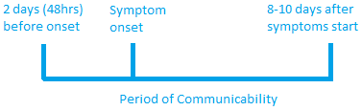
When am I contagious to others?
Period of Communicability
  2 days (48hrs) before symptom onset → 8-10 days after onset
  Most infectious immediately prior and at the onset of symptoms
You can be infectious without symptoms, and still spread the virus to others
Notes:
Source:
https://www.canada.ca/en/public-health/services/diseases/2019-novel-coronavirus-infection/health-professionals/transmission.html
https://www.publichealthontario.ca/-/media/documents/ncov/covid-wwksf/2021/03/wwksf-period-of-communicability-overview.pdf?la=en#:~:text=%E2%80%9CWhat%20We%20Know%20So%20Far,issue%20related%20to%20COVID%2D19.&text=This%20document%20replaces%20the%20previous,of%20an%20updated%20rapid%20review.
A person may be infectious around 2 days or 48hours before showing symptoms and can remain infectious for 8-10 days after symptom onset – being the most infectious around the start of their symptoms. People infected with COVID-19 can spread the disease to others while they have symptoms and sometimes before they know they have symptoms, we call this pre symptomatic; or without any symptoms at all, known as asymptomatic.

Slide 11
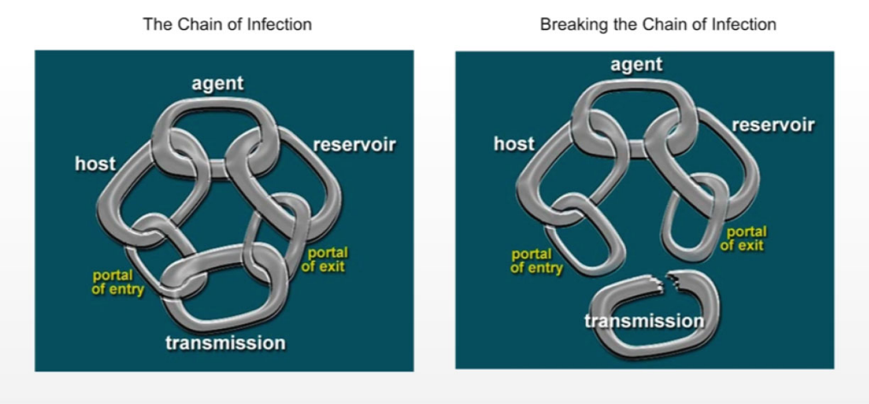
How can I stop the spread of COVID-19?
Healthy Habits:
Follow Public Health Measures:
  Clean your hands often
  Respiratory Etiquette
  Avoid touching your eyes, nose and mouth
  Stay home if you are sick
  Stay away from people who are sick
  Physical distancing
  Universal masking
  Avoiding crowded spaces
  Get vaccinated
Stay up to date with your vaccines, live a healthy life
to reduce your risk of being a susceptible host by getting vaccinated
Notes:
Source:
https://www.who.int/emergencies/diseases/novel-coronavirus-2019/advice-for-public
https://www.cdc.gov/coronavirus/2019-ncov/prevent-getting-sick/prevention.html
To prevent transmission some basic and common infection prevention control measures you should take into consideration at all times are:
General Healthy Habits such as:
Clean your hands often. Especially before touching your eyes, nose or mouth and after blowing your nose, coughing or sneezing. Sanitize with ABHR (70-90%) or wash with soap and water.
Practice Respiratory Etiquette: by coughing or sneezing into your elbow, or into tissues and cleaning your hands after.
Avoid touching your eyes, nose and mouth – especially with unclean, dirty hands
Stay home if you are sick, what you think may not be a big deal could make someone critically ill and of course stay away from people who are sick
Follow any Public Health Guidelines that are in place: such as physical distancing, mask use, avoiding crowded spaces and limiting social interactions
We want to break the chain of infection: Control the portal of entry and exit by washing your hands often, using respiratory etiquette, avoid touching your eyes, nose and mouth and most importantly reduce your risk of being a susceptible host – get your COVID-19 vaccine.

Slide 12
QUESTIONS:
What is the primary source of transmission for COVID-19?
COVID-19 affects only those with weak immune systems and the elderly? (true or false)
What are 3 symptoms of COVID-19?
COVID-19 poses a significant risk to Public Health and our health care system? (true or false)
Notes:
Answers :
Respiratory particles – large droplets, small droplets/aerosols while in close proximity
False – COVID-19 can affect anyone, any age. There is no way to tell who will have a severe illness or long term complications
Fever, New cough or worsening chronic cough, shortness of breath
True

Slide 13
What Are The Benefits of COVID-19 Vaccination?
For you, your loved ones and your community:
Vaccination reduces your risk of getting COVID-19
Significantly reduces your risk of severe illness from COVID-19
Reduces your risk of passing COVID-19 to someone who may not survive it
Helps achieve community immunity (herd immunity)
For those you care for:
Reduces the risk of transmission to your residents and colleagues
Community immunity limits the risk of outbreaks in congregate care
Residents who are immunocompromised/have co-morbidities have the highest risk of severe illness or death from COVID-19
THEIR BEST DEFENSE!
YOUR BEST DEFENSE!
Notes:
Source:
Sunnybrook Health Sciences COVID-19 vaccine education: https://360.articulate.com/review/content/e77b56e0-45ed-42d0-9d9f-1b51eb8277ed/review
There are many benefits to vaccination for ourselves, our loved ones, our residents and our community.
Vaccination reduces your risk of becoming infected with COVID-19, even after one dose.
Vaccination will also significantly reduce the severity of your illness if you are infected with COVID-19.
Vaccination also helps achieve community immunity or herd immunity, within our population. No vaccine will ever be a 100% guarantee, but it is our best defense to protect ourselves and everyone around us.
Your vaccination might stop COVID-19 from reaching someone who would not survive it like someone you provide care for or a friend or family member. Every choice we make right now either increases or decreases risks to ourselves and everyone we come in contact with and everyone they’ll come in contact with. By protecting ourselves we are protecting the people we care for. Elderly, immunocompromised people and those with co-morbidities have the highest risk of developing serious illness and dying. Being vaccinated can greatly decrease the risk to this population and stop transmission.

Slide 14
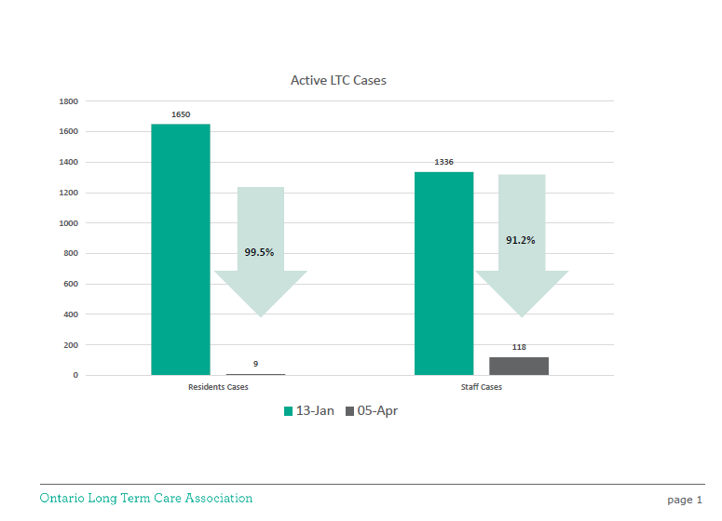
Do COVID-19 Vaccines Work?
Vaccines approved in Canada:
70-95% effective at preventing even mild infection
Nearly 100% effective at preventing hospitalization and death from COVID-19
Notes:
Source:
Sunnybrook Health Sciences COVID-19 vaccine education: https://360.articulate.com/review/content/e77b56e0-45ed-42d0-9d9f-1b51eb8277ed/review
Ontario Long-Term Care Association; Ministry of Health https://covid-19.ontario.ca/data/long-term-care-homes
https://news.ontario.ca/en/release/1000230/ontario-mandates-immunization-policies-for-long-term-care-homes
The vaccines currently approved for use in Canada have been shown in clinical trials to be 70-95% effective at preventing even mild infection with COVID-19. More importantly they are 100% effective at preventing hospitalization and death from COVID-19! Countries who were able to begin vaccination in 2020 show a dramatic decrease in hospitalizations related to COVID-19 despite easing of Public Health restrictions.
In Ontario the evidence of increase vaccination was clear in LTCH from January to April 2021 with over 90% resident vaccination and 55% of staff. As you can see active COVID-19 cases from Jan 13th to April 5th, 2021 dropped by 99.5% in residents and 91.2% with staff – clearly demonstrating the effects of vaccination and community immunity at work in LTCH across Ontario.
As of May 30, 2021, it is estimated that, across Ontario, 97 per cent of long-term care residents are fully immunized and more than 89 per cent of staff have received at least their first dose, with approximately 66 per cent fully immunized.

Slide 15
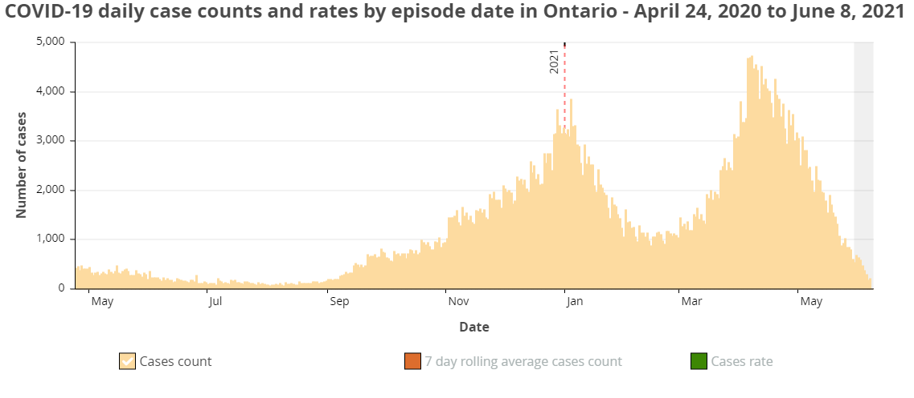
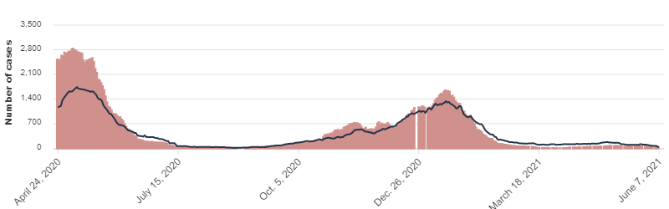
Wave 3
Wave 2
COVID-19 daily case count LTCH residents and staff in Ontario – April 24, 2020 to June 7th, 2021
Dec, 14th Start of Vaccination in LTCH
No Wave 3
Wave 1
Wave 2
Source: Ministry of Health, Ontario Cases https://covid-19.ontario.ca/data/long-term-care-homes
Notes:
Source:
https://covid-19.ontario.ca/data/long-term-care-homes
https://www.publichealthontario.ca/en/data-and-analysis/infectious-disease/covid-19-data-surveillance/covid-19-data-tool?tab=trends
The top image in yellow shows COVID-19 daily case counts in Ontario from April 24th 2020 until June 8th 2021 – with waves 2 and 3 clearly evident.
The image below represents active daily cases in LTCH, the red is residents, and the black line is staff. For the same time period.
As you can see at the end of wave 2 LTCH active cases continued the downward trend due to an increase in vaccinations. In LTCH there was no third wave as you can see compared to active cases in Ontario's general population.

Slide 16
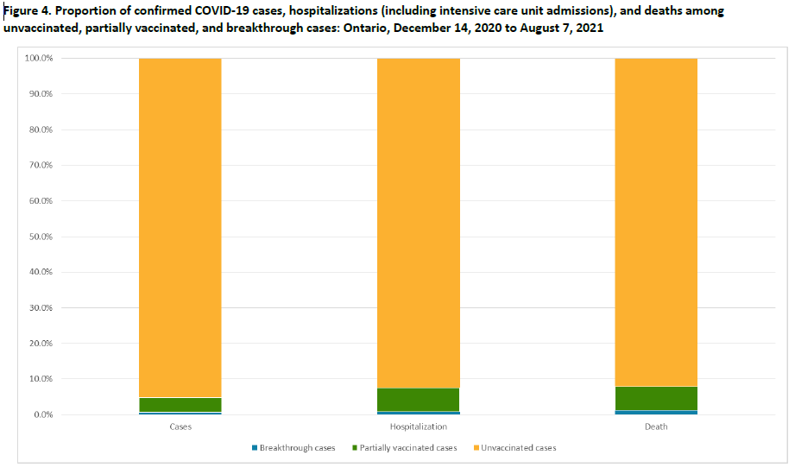
Do COVID-19 Vaccines Work?
95.2% COVID-19 cases are in
unvaccinated individuals
Unvaccinated (yellow):
92.5% of hospitalizations
92.1% of deaths
Partially Vaccinated (green)
Fully Vaccinated (blue):
0.8% of hospitalizations
1.2% of deaths
Source: Public Health Ontario. (2021). Confirmed Cases of COVID-19 Following Vaccination in Ontario: December 14, 2020 to August 7, 2021, linked here
Notes:
*Statistical information updated August 18th, 2021 using the sources provided
Source:
https://covid-19.ontario.ca/data/case-numbers-and-spread#vaccine-status-data
https://www.publichealthontario.ca/-/media/documents/ncov/epi/covid-19-epi-confirmed-cases-post-vaccination.pdf?sc_lang=en
The data supporting vaccinations is becoming more apparent in our general population, not just in LTCH, as the vaccination rates continue to increase and the forth wave effects mostly unvaccinated individuals. The evidence is clear that the rate of COVID-19 in unvaccinated individuals is higher compared to fully vaccinated individuals. Those who are unvaccinated are approximately 8.1 times more likely to become a case of COVID-19 compared to those who are fully vaccinated
As you can see in the graph unvaccinated cases, in yellow, accounted for the majority (95.2%) of COVID-19 cases reported since December 14, 2020 and up to August 7, 2021, with fully vaccinated cases, in blue, accounting for only 0.6% or 2455 individual cases out of 9,320,603 fully vaccinated individuals. (data from August 7th, 2021).
Similar trends are observed for hospitalizations and deaths, with unvaccinated cases, in yellow, accounting for 92.5% of hospitalizations and 92.1% of deaths and fully vaccinated cases, in blue, accounting for 0.8% of hospitalizations and 1.2% of deaths.

Slide 17
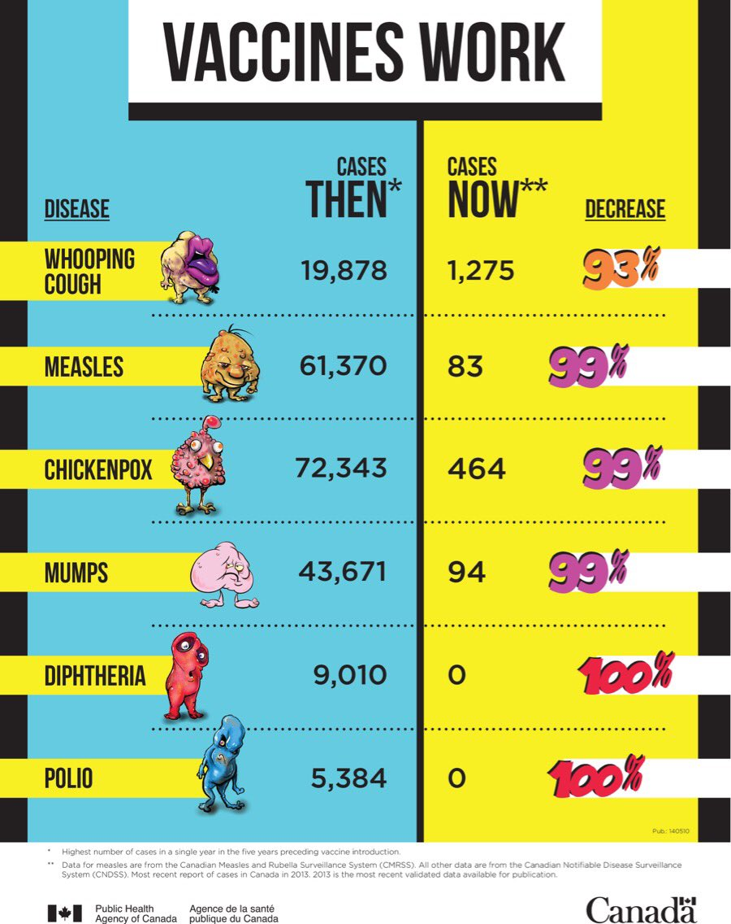
Immunizations
Immunization is widely recognized as one of the greatest public health achievements of the twentieth century. Vaccines save lives, prevent the spread of diseases and reduce health care costs. Immunization programs are an important foundation of Ontario’s health system.
Notes:
Source:
https://www.canada.ca/en/public-health/services/publications/healthy-living/vaccines-work-infographic.html
https://www.publichealthontario.ca/en/health-topics/immunization
Immunization is widely recognized as one of the greatest public health achievements of the twentieth century. Vaccines save lives, prevent the spread of diseases and reduce health care costs. Immunization programs are an important foundation of Ontario’s health system
This poster compares the number of cases of 6 vaccine-preventable diseases in Canada before and since the introduction of vaccines.
It is interesting to compare the ‘then cases’ to the ‘now case’ and note that Polio has zero cases now, which is due to the benefits of vaccination programs. When community immunity is compromised by vaccine hesitancy or outright refusal we see clusters of these vaccine preventable diseases, even in developed counties like Canada, the USA and in Europe.
Let’s take a closer look at covid-19 vaccines!

Slide 18
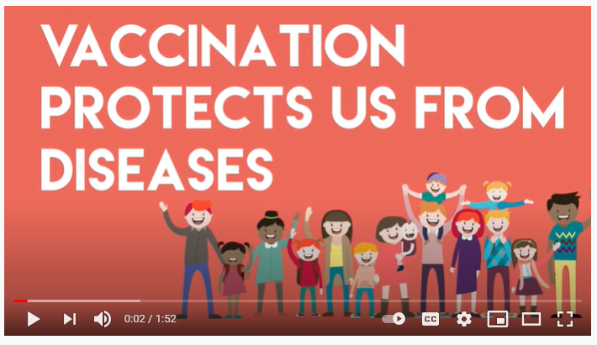
What is a vaccine?
Click here to play the YouTube video
Video source: Immunize Canada. (February 23rd, 2017). Vaccine Safety - Immunize Canada. Retrieved from: https://www.youtube.com/watch?v=Y4N4_1PNtfk
Notes:
Source: https://www.who.int/news-room/q-a-detail/vaccines-and-immunization-what-is-vaccination
Vaccination is a simple, safe, and effective way of protecting people against harmful diseases, before they come into contact with them. It uses your body’s natural defenses to build resistance to specific infections and makes your immune system stronger.
Vaccines train your immune system to create antibodies, just as it does when it’s exposed to a disease. However, because vaccines contain only killed or weakened forms of germs like viruses or bacteria, they do not cause the disease or put you at risk of its complications.
Most vaccines are given by an injection, but some are given orally (by mouth) or sprayed into the nose.
Vaccines reduce risks of getting a disease by working with your body’s natural defenses to build protection. When you get a vaccine, your immune system responds. It:
Recognizes the invading germ, such as the virus or bacteria.
Produces antibodies. Antibodies are proteins produced naturally by the immune system to fight disease.
Remembers the disease and how to fight it. If you are then exposed to the germ in the future, your immune system can quickly destroy it before you become unwell.
The vaccine is therefore a safe and clever way to produce an immune response in the body, without causing illness.
Our immune systems are designed to remember. Once exposed to one or more doses of a vaccine, we typically remain protected against a disease for years, decades or even a lifetime. This is what makes vaccines so effective. Rather than treating a disease after it occurs, vaccines prevent us in the first instance from getting sick.

Slide 19
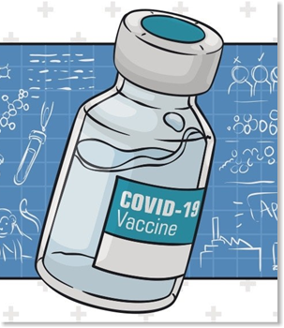
What are the types of COVID-19 Vaccines available?
Currently authorized and recommended COVID-19 vaccines:
    Are safe,
    Are effective, and
    Reduce your risk of severe illness
The best?
The first one that is available to you! Do not wait for a specific brand!
All vaccines are rigorously tested and then reviewed and approved by Health Canada. If you have questions or concerns always speak to a trusted health care provider
Notes:
Source:
https://www.cdc.gov/coronavirus/2019-ncov/vaccines/different-vaccines.html
https://www.canada.ca/en/public-health/services/diseases/2019-novel-coronavirus-infection/prevention-risks/covid-19-vaccine-treatment.html
https://www.canada.ca/en/public-health/services/diseases/2019-novel-coronavirus-infection/awareness-resources/know-vaccine.html
Only vaccines that are proven to be safe, effective and of high quality are authorized for use in Canada. The first vaccine available is your best bet at preventing COVID-19 infection. All currently authorized and recommended COVID-19 vaccines are safe, effective and reduce your risk of severe illness.
We will now look into viral vector and mRNA vaccines in a bit more detail including videos from Dr. Guillaume Poliquin, Acting Vice President of Canada’s National Microbiology Laboratory.

Slide 20
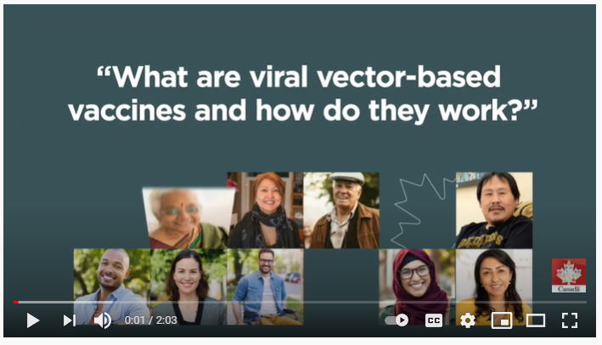
Viral Vector Vaccines
Click here to play the YouTube video
Video source: Healthy Canadians. (June 9th, 2021). What are viral-vector based vaccines and how do they work? Retrieved from https://www.youtube.com/watch?v=wnVLXLHYVes

Slide 21
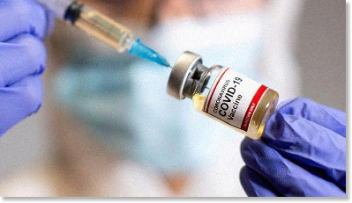

How Do They Work?
Viral Vector COVID-19 Vaccines
Use a modified version of a different virus (the vector) to deliver important instructions to our cells
  The cell displays the COVID-19 spike protein on its surface
  Our immune system recognizes the spike protein, triggering an immune response
  Our bodies are now prepared to protect from future COVID-19 exposure
Notes:
Source:
https://www.cdc.gov/coronavirus/2019-ncov/vaccines/different-vaccines/viralvector.html
Video: https://www.youtube.com/watch?v=wnVLXLHYVes
*if the video can be used, edit down the speaking notes slide content only
Viral vector vaccines: use a modified version of a different virus (the vector) to carry important instructions to our cells.
For COVID-19 viral vector vaccines, the vector (not the virus that causes COVID-19, but a different, harmless virus) will enter a cell in our body and then use the cell’s machinery to produce a harmless piece of the virus that causes COVID-19. This piece is known as a spike protein and it is only found on the surface of the virus that causes COVID-19.
Once inside the cell, the SARS-CoV-2 (or COVID-19) spike protein genes are transcribed into mRNA than translated into spike proteins on the cells surface. The cell displays the spike protein on its surface, and our immune system recognizes it doesn’t belong there. This triggers our immune system to begin producing antibodies and activating other immune cells to fight off what it thinks is an infection.
Our bodies have now learned how to protect us against future infection with the virus that causes COVID-19. The benefit is that we get this protection from a vaccine, without ever having to risk the serious consequences of getting sick with COVID-19.

Slide 22
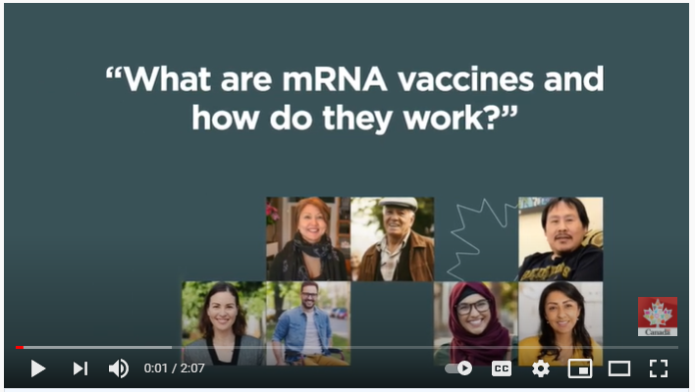
mRNA Vaccines
Click here to play the YouTube video
Video source: Healthy Canadians. (June 9th, 2021). What are mRNA vaccines and how do they work? Retrieved from: https://www.youtube.com/watch?v=zmmdCe8lNOw

Slide 23

How Do They Work? mRNA COVID-19 Vaccines
Teaches our cells how to make a protein (or a piece of protein)
  The cell displays the protein piece on its surface
  Our immune system recognizes the spike protein, and begins building an immune response
  Our bodies are now prepared to protect from future COVID-19 exposure
New type of vaccine
Notes:
Source:
https://www.cdc.gov/coronavirus/2019-ncov/vaccines/different-vaccines/mRNA.html
VIDEO: https://www.youtube.com/watch?v=zmmdCe8lNOw
*if the video can be used, edit down the speaking notes to slide content only
mRNA vaccines: are a new type of vaccine to protect against infectious diseases. To trigger an immune response, many vaccines put a weakened or inactivated germ or different as discussed with viral vector vaccines, into our bodies. Not mRNA vaccines. COVID-19 mRNA vaccines give instructions for our cells to make a harmless piece of what is called the “spike protein.” The spike protein is found on the surface of the virus that causes COVID-19.
Once the mRNA instructions are inside the immune cells, the cells read them to make the protein piece. After the protein piece is made, the cell breaks down the instructions and gets rid of them.
Next, the cell displays the protein piece on its surface. Our immune systems recognize that the protein doesn’t belong there and begin building an immune response and making antibodies, like what happens in natural infection against COVID-19.
At the end of the process, like with all vaccines, our bodies have learned how to protect against future infection.
The benefit of COVID-19 vaccines, like all vaccines, is those vaccinated gain this protection without ever having to risk the serious consequences of getting sick with COVID-19 or other diseases vaccines are used for.

Slide 24

Myths about COVID-19 Vaccines
General:
It is NOT possible to get COVID-19 from a COVID-19 vaccine
Does not affect or change our DNA in any way
Viral Vector Vaccines:
Do not cause an infection with COVID-19 or the vector used in the vaccine
mRNA Vaccines:
Does not enter the part of the cell that contains our DNA (cell nucleus)
Does not remain in our system-the cell breaks down and gets rid of the mRNA as soon as it is finished using it
Notes:
These are some common myths about COVID-19 vaccines:
In General:
It is not possible to get COVID-19 from a COVID-19 vaccine – there is no live virus
Vaccines do not affect our DNA in any way – they never enter the cell nucleolus
Viral Vector Vaccines:
Do not cause an infection with COVID-19 or the vector virus used in the vaccine
mRNA Vaccines:
Does not enter the part of the cell that contains our DNA (cell nucleus)
Does not remain in our system-the cell breaks down and gets rid of the mRNA as soon as it is finished using it – leaving the COVID-19 spike protein on the cell surface

Slide 25
Questions:
Do mRNA vaccines can change your DNA?
You get COVID-19 from the vaccine?
Notes:
Answers:
False - the mRNA in mRNA COVID-19 vaccines does not interact with your DNA in anyway.
No: it is not possible to get COVID-19 from the vaccine. Vaccines only contain the blueprint to make a protein on the surface (spike protein) of the COVID-19 virus – which is harmless on its own. So your body will create antibodies that will recognize and attack the real COVID-19 virus if you are ever exposed to the virus in the future.

Slide 26
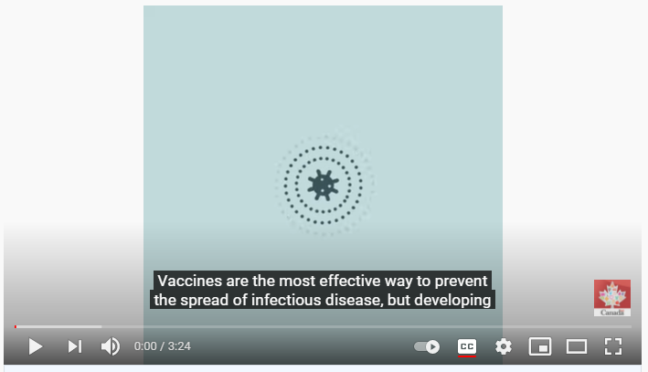
Process of vaccine development
Click here to play the YouTube video
Video source: Healthy Canadians. (December 21st, 2020). COVID-19: How vaccines are developed. Retrieved from: https://www.youtube.com/watch?v=Y51ZgZCS8J0

Slide 27
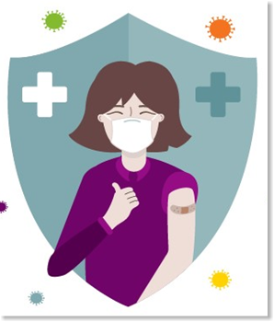
Are COVID-19 Vaccines safe?
Canada
50,254,577 doses given (more than 50 million)
12,006 adverse events following immunization (0.023%)
3063 serious side effects reported (0.006%)
Ontario
19,810,821 doses given (almost 20 million)
9,688 adverse events following immunization (0.048%)
536 serious side effects reported (0.003%)
That is safer than commonly used medications like Advil and Tylenol!
Notes:
*Statistical information updated August 18th, 2021 using the sources provided
Source:
Sunnybrook COVID-19 Vaccine Education: https://360.articulate.com/review/content/e77b56e0-45ed-42d0-9d9f-1b51eb8277ed/review
https://www.canada.ca/en/public-health/services/diseases/2019-novel-coronavirus-infection/awareness-resources/know-vaccine.html
https://www.publichealthontario.ca/-/media/documents/ncov/epi/covid-19-aefi-report.pdf?sc_lang=en
All steps to evaluate standards of safety, efficacy, and quality were met in the approval process for the COVID-19 vaccines.
As of August 6th, 2021 over 50 million doses of the COVID-19 vaccine have been administered across Canada alone (and over 4.7 billion doses have been administered worldwide). In Canada, only 3063 serious side effects were reported-that means a serious adverse event rate of 0.006%.
In Ontario almost 20 million doses have been administered, with only 536 serious side effects reported. That is safer than commonly used medications like Advil and Tylenol.
The vaccine was able to be created quickly because of global efforts with the worlds leading scientists focused on a single task. There were essentially unlimited financial, scientific, and technological resources. No steps were skipped in the process of developing, testing, approving and producing the vaccine.

Slide 28
What are the most common side effects from the COVID-19 vaccines?
Localized reaction at the injection site: | Systemic reaction within the body:
Redness Soreness Swelling | Mild fever Chills Headache Fatigue Muscle aches Joint pain
Notes:
Source:
https://www.canada.ca/en/public-health/services/diseases/coronavirus-disease-covid-19/vaccines/what-expect-vaccination.html
https://www.publichealthontario.ca/-/media/documents/ncov/epi/covid-19-aefi-report.pdf?sc_lang=en
After getting vaccinated, it is common and normal to have temporary side effects. These can last a few hours to a few days after vaccination.
This is the body's natural response, as it's working hard to build protection against the disease.
Localized reactions occur at the site of the injection and can include: redness, soreness and swelling at the site.
Reactions can also be felt throughout different parts of the body, these are known are ‘systemic reactions’ and can include: mild fever, chills, headache, fatigue, muscle and joint aches and/or pain.
The most common side effects reported from the COVID-19 vaccine are: fatigue, headache, muscle aches, mild fever and/or chills, which occurred during the first week after vaccination, but were most commonly one or two days after receiving of the vaccine.

Slide 29
Severe allergic reactions
Anaphylaxis | Blood Clots | Myocarditis
155 cases out of over 50 million doses in Canada Rate consistent with other common vaccines Much lower than anaphylaxis rate for common medications like penicillin. | For AstraZeneca, very rare: 1 in 55,000 to 1 in 500,000 Lower rate than air flights of > 4 hours which is 1 in 4,655. COVID-19 illness increases the risk of blood clots. | 246 cases out of almost 20 million doses (Ontario Data) Only found with mRNA vaccines Usually mild cases go away without notice and complications
Notes:
*Statistical information updated August 18th, 2021 using the sources provided
Source:
Adapted from Sunnybrook: https://360.articulate.com/review/content/e77b56e0-45ed-42d0-9d9f-1b51eb8277ed/review
https://health-infobase.canada.ca/covid-19/vaccine-safety/summary.html
https://www.publichealthontario.ca/-/media/documents/ncov/epi/covid-19-aefi-report.pdf?sc_lang=en
Serious allergic reactions are rare, but do occur. They include anaphylaxis (a severe allergic reaction) which has been reported 155 times for all COVID-19 vaccines across Canada. This rate is consistent with other commonly administered vaccines, like the flu shot or shingles vaccine, and is MUCH lower than the rate of anaphylaxis to common medications like penicillin.
There have been some reports of blood clots related to a specific COVID-19 vaccine made by AstraZeneca. This is very rare estimated to occur between 1 in 55,000 to 1 in 500,000 people. Compare this to the incidence of blood clots after flights that are greater than 4 hours which is 1 in 4,655. Also, getting infected with COVID-19 increases the risk of blood clots to as high as 1 in 5 in hospitalized patients with COVID-19.
Myocarditis (or heart inflammation) reported data is not yet available nationally; however in Ontario 246 cases have been reported out of 20 million vaccines (August 7th data).
Serious reactions following immunization should be reported to a health care provider. This information is reported and used to monitor adverse events following immunization with vaccines to ensure the continued safety of vaccines in Canada.
Canada’s National Advisory Committee on Immunization (NACI) recommends:
If you have a severe allergic reaction (such as anaphylaxis) after getting your first dose of a COVID-19 vaccine, you should not get a subsequent dose of a similar type of COVID-19 vaccine. You should talk to your primary care provider to see if another type of COVID-19 vaccine would be a good idea for you.

Slide 30

Talk to your health care provider if you:
Are currently unwell or have signs and symptoms of COVID-19
Have had a previous allergic reaction to any of the ingredients in the COVID-19 vaccine, or previous vaccines (including first COVID-19 vaccination)
Have any allergies/allergic conditions
Are immunosuppressed due to disease/treatment or have been diagnosed with an autoimmune condition
Have a bleeding disorder or are taking medication that could affect blood clotting (this information will help the health care provider prevent bleeding/bruising at the injection site)
Have received any other vaccine in the past 14 days
You can still have your COVID-19 vaccine if you are pregnant or breastfeeding (consult your health care provider if you have any questions or concerns)
Not all of these are mean that you should not get the vaccine, but you should talk to your health care provider about their recommendation based on your known or reported health history.
Notes:
Source:
Ministry of Health - COVID-19_vaccine_info_sheet%20(1).pdf
https://www.health.gov.on.ca/en/pro/programs/publichealth/coronavirus/docs/vaccine/COVID-19_vaccination_rec_special_populations.pdf
Before receiving the vaccine, talk to your health care provider or clinic staff if:
• You are currently feeling unwell or have signs and symptoms of COVID-19.
• You have had a previous allergic reaction to a COVID-19 vaccine or any ingredients in the COVID-19 vaccines, or any other vaccine.
• You have any allergies or allergic conditions.
• You are immunosuppressed due to disease or treatment or have been diagnosed with an autoimmune condition.
• You have a bleeding disorder or are taking medication that could affect blood clotting. This information will help the healthcare provider prevent bleeding or bruising from the needle at the time of vaccination.
• You have received any other vaccine (not COVID-19 vaccine) in the past 14 days.
You can still get your vaccine if you are pregnant or are breastfeeding, talk to your health care provider for any concerns or questions.
*See speaking notes for pop up message
Not all of these are mean that you should not get the vaccine, but you should talk to your health care provider about the recommendation they provide for you to have the vaccine or a delay in receiving the vaccine recommendation based on your known or reported health history.

Slide 31

Before Immunization
Communication is Key!
Let your health care provider know about any fears, stressors or anxiety related to immunizations and what could be done to make the experience more comfortable.
Notes:
The fear of vaccinations is commonly thought of as an issue that affects only children. However, fear of vaccinations affects many people of different ages for different reasons. The good news is there are strategies to consider that can help reduce fear, stress and anxiety that is either related to the needle, receiving an immunization or being in a health care setting.
Communication is so important! When a health care provider better understands any barriers to immunization they can ensure they are providing the best support such as: providing additional time to support, allowing time for deep breathing exercises, distraction techniques or listening to music, reading or videos. As well, if you need someone to just keep talking to you, then they need to know this is helpful.
Topical anesthetics, commonly called numbing cream can be applied prior to immunization. It is a good idea to talk to your pharmacist or health care provider about the proper time to apply the cream before receiving an immunization, and proper location of application for the best effect.
Have your questions answered before your appointment, so you know what to expect and have a plan. This will make you feel more comfortable by being better prepared and in control.

Slide 32
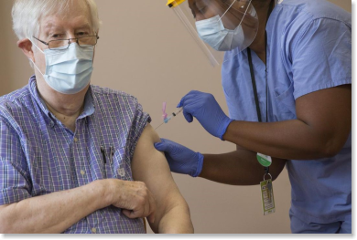
During Immunization
Sit upright during vaccination
Wear a short-sleeved or loose-fitting top
Relax your arm by letting it feel loose
Use deep breathing to help you relax and feel calm
If you feel dizzy or faint, tell the person who's vaccinating you right away
Distract yourself by reading or listening to music, or have a conversation
Talk to your health care provider ahead of time about pain relief
Notes:
Source:
https://www.canada.ca/en/public-health/services/diseases/coronavirus-disease-covid-19/vaccines/what-expect-vaccination.htmlce:
Once you have your plan and have thought about what strategies will work for you remember these tips for a comfortable vaccination experience.
Sit upright during vaccination
Wear a loose fitting top that is short sleeve and can roll up easy over the shoulder or the neck of the top can easily drop down over the shoulder
Keep your arm as relaxed as possible, so the muscle is relaxed and your arm is loose like a spaghetti noodle
Use deep breathing exercises to keep your body relaxed and;
If you feel dizzy or faint tell someone right away to ensure you’re in a safe position
Distract yourself with reading, or listening to music or continue a conversation
Talk to your health care provider ahead of time about medication recommendations for pain relief and discomfort

Slide 33
After immunization
Confirm what medications are recommended for any pain, discomfort at the immunization site or fever. Recommendations can be provided by clinic immunization staff, pharmacist or your health care provider.
Side effects vary for everyone but normally last a few hours to a few days
Applying a cool compress to the site can reduce swelling and provide comfort.
Keep your arm moving
Drink fluids to maintain hydration
Some people may schedule their vaccination around pre-scheduled days off to be home the next day
Notes:
You can also take medicine after your vaccination to help with any pain or to lower a fever. Ask your health care provider what they recommend to manage symptoms.
You can also:
Apply a clean, cool wet cloth or compress over the injection site area, this can help to reduce discomfort associated with pain or swelling at the site.
Keep your arm moving, but do not overexert with strenuous overuse or heavy exercise.
Drink plenty of fluids to maintain hydration, which helps other symptoms such as: headaches
Although most people will not have significant side effects, some people may consider scheduling their vaccination, so they are home if they are concerned about not feeling well the next day.

Slide 34
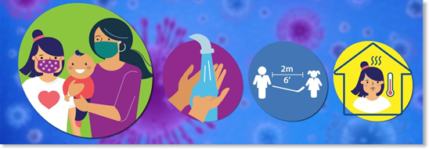
Continuing Public Health measures
Continue to stay home when you are feeling unwell
Follow the current testing guidelines from your local public health agency if you develop symptoms similar to COVID-19
Continue to follow public health restrictions that are in place
Clean your hands often with soap and water or an alcohol based hand rub
Personal Protective Equipment (PPE) required for use when providing direct care must still be worn as indicated. COVID-19 is not the only infectious organism around!
Notes:
Source:
https://www.canada.ca/en/public-health/services/diseases/coronavirus-disease-covid-19/vaccines/what-expect-vaccination.html
It is essential that everyone continues to follow public health measures to help stop the spread of COVID-19 in our communities. As more vaccines are given, some of the more restrictive public health measures may be lifted.
You won’t develop significant protection against COVID-19 until about two weeks after you get vaccinated. Remember that for the two-dose COVID-19 vaccines, the second dose of the vaccine is needed for the greatest protection. It is important to follow Public Health measures in the 14 days following immunization and thereafter until more vaccines are received in workplaces and communities.

Slide 35
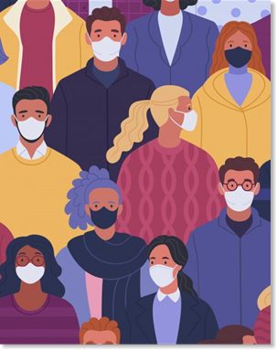
Important reasons to consider the vaccine
Help protect yourself from getting sick with COVID-19 if you are exposed to the virus
Avoid spreading it to other people
Help control the pandemic
Help to get back to normal routines and activities
Protect yourself, family, friends, community and your residents and co-workers, and get back to what you enjoy and have missed the most!
Notes:
Source:
Adapted from Sunnybrook: https://360.articulate.com/review/content/e77b56e0-45ed-42d0-9d9f-1b51eb8277ed/review
The COVID-19 vaccines help protect you from getting sick with COVID-19 if you are exposed to the virus. They also help in reducing the spread to others if you become infected and spread it to family, friends, co-workers that may not survive.
Getting your vaccine is an important step in ending the pandemic. It is safe and effective. We can already see the impact the vaccine has had on the population. In the first two waves, the elderly were impacted more with the virus, but this changed significantly during the third wave. Those over 75 accounted for few cases and the majority of the infections happening among younger ages without broad access to COVID-19 vaccines.
It is becoming clear that getting vaccinated will be the key to returning to many of the things we miss the most. Please consider getting the vaccine. Protect yourself, your family, and help bring back whatever it is that you’ve missed the most over this past year.
And now Dr. Supriya Sharma Chef Medical Advisor for Health Canada on her reasons for being vaccinated

Slide 36
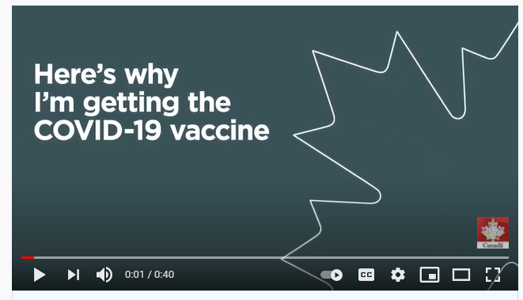
#MyWhy on COVID Vaccination
Click here to play the YouTube video
Video source: Healthy Canadians. (May 27th, 2021). #MyWhy on getting COVID-19 vaccine: Dr. Supriya Sharma. Retrieved from: https://www.youtube.com/watch?v=p13YsMvSd-8

Slide 37
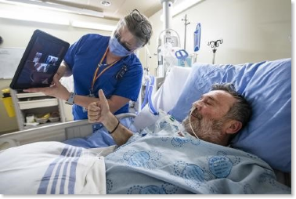
Risks of not getting COVID-19 Vaccine
Delaying or choosing not to be vaccinated means you are risking the following:
Your health: as you will have an increased risk of severe illness and death. Additionally, you may develop a long-term, post COVID-19 condition
The health of others: as you may unintentionally pass COVID-19 to someone who may not survive such as: friends, family, coworkers and those you provide care to.
The health of your community: as decreased vaccination rates will lower community immunity (herd immunity) and put your community at risk
Delay return to normal: with the continued risk of COVID-19 transmission, there is increased likelihood of additional COVID-19 waves and the social and economic impacts of public health measures used to control transmission or spread.
Notes:
Source:
Sunnybrook COVID-19 vaccine education: https://360.articulate.com/review/content/e77b56e0-45ed-42d0-9d9f-1b51eb8277ed/review

Slide 38
The decision is yours to make!
What do you choose?
I would like to proceed with my COVID-19 vaccination
I would like to decline COVID-19 vaccination at this time or would like more time to make a decision
Notes:
We hope this COVID-19 vaccine education module has provided details to help provide clarification, answer questions and provide you with information based on evidence and research to help you make an informed decision about COVID-19 vaccination.
The decision is yours to make. It is important to have your questions answered and seek additional information if you still have more questions to help make a decision that is best for you. If you have further questions use reliable sources of health information, such as the resources listed in this presentation. Talking to a trusted and well informed health care professional can also be helpful.
Thank you for your attention and consider the important role of vaccination to protect yourself, family and communities in which you live and work in.
We acknowledge your decline in COVID-19 vaccination at this time but hope that this education module gave you resources to re-visit your decision. Your decision can be revisited at any time based on vaccine availability. (continues to certificate of completion) link to Resources page

Slide 39
CERTIFICATE OF COMPLETION
This certificate acknowledges that
First Name, Last Name
Has successfully completed the COVID-19 Vaccine Education Module
February 04, 20XX
Date Completed on

Slide 40
Resources
COVID-19 Vaccines and Pregnancy:
COVID-19 Vaccine Pregnancy Support Tool
WHO Recommendations: Vaccines and Pregnancy
COVID-19 Data Trackers:
Vaccination Tracker Canada
COVID-19 Global Dashboard
Long-Term Care Home COVID Data
Ontario COVID-19 Data
Public Health Ontario COVID-19 Data & Surveillance
Booking your COVID-19 Vaccine:
How to Book a COVID-19 Vaccine
Local Public Health Unit Vaccine Resources:
Public Heath Regions
Vaccine Safety:
COVID-19 Awareness Resources
Vaccine Safety
How Vaccines are Developed (video)
COVID-19 Vaccine Approval Process and Safety
Different COVID-19 Vaccines
COVID-19 Vaccination Recommendations for Special Populations
Recommendations on the use of COVID-19 Vaccines
Websites:
Government of Canada COVID-19
Government of Ontario COVID-19
Public Health Ontario COVID-19
Ministry of Health and LTC COVID-19

Slide 41
References
Alberta Health Services. (June 16th, 2021). 2020-2021 COVID-19 Immunization Orientation. Retrieved from: https://www.albertahealthservices.ca/assets/info/hp/cdc/if-hp-cdc-ipsm-covid-19-imm-orientation-ppt.pdf
Centers for Disease Control and Prevention. (March 23rd, 2021). About COVID-19. Retrieved from: https://www.cdc.gov/coronavirus/2019-ncov/your-health/about-covid-19.html
Centers for Disease Control and Prevention. (April 8, 2021). Long-Term Effects. Retrieved from: https://www.cdc.gov/coronavirus/2019-ncov/long-term-effects.html
Centers for Disease Control and Prevention. (June 11th, 2021). Guidance for unvaccinated people: protect yourself. Retrieved from: https://www.cdc.gov/coronavirus/2019-ncov/prevent-getting-sick/prevention.html
Centers for Disease Control and Prevention. (May 27th, 2021). Types of Vaccines Available. Retrieved from: https://www.cdc.gov/coronavirus/2019-ncov/vaccines/different-vaccines.html
Ministry of Health. (May 27th, 2021). COVID-19 Vaccination Recommendations for Special Populations. Retrieved from: https://www.health.gov.on.ca/en/pro/programs/publichealth/coronavirus/docs/vaccine/COVID-19_vaccination_rec_special_populations.pdf
Public Health Agency of Canada. (May 28th, 2021). An Advisory Committee Statement (ACS) National Advisory Committee of Immunization (NACI): Recommendations on the use of COVID-19 Vaccines. Retrieved from: https://www.canada.ca/content/dam/phac-aspc/documents/services/immunization/national-advisory-committee-on-immunization-naci/recommendations-use-covid-19-vaccines/recommendations-use-covid-19-vaccines-en.pdf

Slide 42
References
Public Health Agency of Canada. (June 14th, 2021). Coronavirus disease (COVID-19): Symptoms and treatment. Retrieved from: https://www.canada.ca/en/public-health/services/diseases/2019-novel-coronavirus-infection/symptoms.html
Public Health Agency of Canada. (March 12th, 2021). COVID-19: Main modes of transmission. Retrieved from: https://www.canada.ca/en/public-health/services/diseases/2019-novel-coronavirus-infection/health-professionals/main-modes-transmission.html
Public Health Agency of Canada. (February 15th, 2021). COVID-19 for health professionals: Transmission. Retrieved from: https://www.canada.ca/en/public-health/services/diseases/2019-novel-coronavirus-infection/health-professionals/transmission.html
Public Health Agency of Canada. (June 21st, 2021). Vaccines and treatments for COVID-19: Progress. Retrieved from: https://www.canada.ca/en/public-health/services/diseases/2019-novel-coronavirus-infection/prevention-risks/covid-19-vaccine-treatment.html
Public Health Agency of Canada. (April 15th, 2021). The facts about COVID-19 vaccines. Retrieved from: https://www.canada.ca/en/public-health/services/diseases/2019-novel-coronavirus-infection/awareness-resources/know-vaccine.html
Public Health Agency of Canada. (May 14th, 2021). Vaccines for COVID-19: What to expect at your vaccination. Retrieved from: https://www.canada.ca/en/public-health/services/diseases/coronavirus-disease-covid-19/vaccines/what-expect-vaccination.html
Public Health Ontario. (April, 5th, 2021). About Coronavirus (COVID-19). Retrieved from: https://www.publichealthontario.ca/en/diseases-and-conditions/infectious-diseases/respiratory-diseases/novel-coronavirus/about-covid-19

Slide 43
References
Public Health Ontario. (May 19th, 2021). COVID-19 Variants of Concern (VOCs). Retrieved from: https://www.publichealthontario.ca/en/diseases-and-conditions/infectious-diseases/respiratory-diseases/novel-coronavirus/variants
Public Health Ontario. (February 8th, 2021). COVID-19 overview of the period of communicability – what we know so far. Retrieved from: https://www.publichealthontario.ca/-/media/documents/ncov/covid-wwksf/2021/03/wwksf-period-of-communicability-overview.pdf?la=en
Public Health Ontario. (May 20th, 2021). COVID-19 Transmission Through Large Respiratory Droplets and Aerosols… What We Know So Far. Retrieved from: https://www.publichealthontario.ca/-/media/documents/ncov/covid-wwksf/2021/05/wwksf-transmission-respiratory-aerosols.pdf?la=en
Sunnybrook Health Sciences Centre. COVID-19 Vaccine module. Accessed through: https://360.articulate.com/review/content/e77b56e0-45ed-42d0-9d9f-1b51eb8277ed/review
World Health Organization. (October 12th, 2020). Coronavirus disease (COVID-19). Retrieved from: https://www.who.int/emergencies/diseases/novel-coronavirus-2019/question-and-answers-hub/q-a-detail/coronavirus-disease-covid-19#:~:text=symptoms
World Health Organization. (December 30th, 2020). Vaccines and immunization: what is vaccination? Retrieved from: https://www.who.int/news-room/q-a-detail/vaccines-and-immunization-what-is-vaccination

Slide 44

Thank you!
How to contact our team for questions or support
Contact us by email:
SEhubintake@kingstonhsc.ca
Visit our website at:
SE IPAC Hub and Spoke | KHSC Kingston Health Sciences Centre (kingstonhsc.ca)
Notes:
If you have any questions in follow up you can e-mail our team or visit our website where we will have some of the formats of the module available.

