Slide 1



Superovulation & Intrauterine Insemination
Kingston Reproductive Centre
Virtual Teaching Visit
Prepared by Dr. Bryden Magee, MD FRCSC 2020
Notes:
Welcome to the patient education session on superovulation and intrauterine insemination at the Kingston Reproductive Centre at Kingston General Hospital. My name is Dr. Bryden Magee and I am one of the reproductive endocrinologist and infertility specialists at the KRC.

Slide 2

Learning Objectives
Become familiar with the process of superovulation & intrauterine insemination (SO/IUI)
Outline the stages of SO/IUI
Review medications and side effects
List the risks of SO/IUI
Discuss next steps
Notes:
The purpose of this powerpoint is to help you become familiar with the process of superovulation and intrauterine insemination before your first treatment cycle. I will provide a general overview of SO/IUI, then take you step by step through all the stages treatment, review medications and common side effects, and discuss the risks associated with SO/IUI. Then, I will direct you towards your next steps in order to start treatment at the Kingston Reproductive Centre

Slide 3
Overview of SO/IUI
SUPEROVULATION
Fertility drugs stimulate 2-4 egg follicles at a time
MONITORING
Ultrasound and bloodwork is used to monitor your response
INSEMINATION
Sperm is placed in the uterus so fertilization can occur naturally
SPERM WASHING
Semen is processed in the lab just prior to ovulation
Overview of SO/IUI
Notes:
The process of Superovulation/Intrauterine Insemination involves taking fertility drugs in the first 1 or 2 weeks of your cycle to make more than one egg follicle grow. This growth is carefully monitored with vaginal ultrasound and bloodwork and when the eggs are ready, semen is processed in the lab so that is can be placed directly into the womb, or uterus. This allows egg and sperm to meet naturally inside your body.

Slide 4
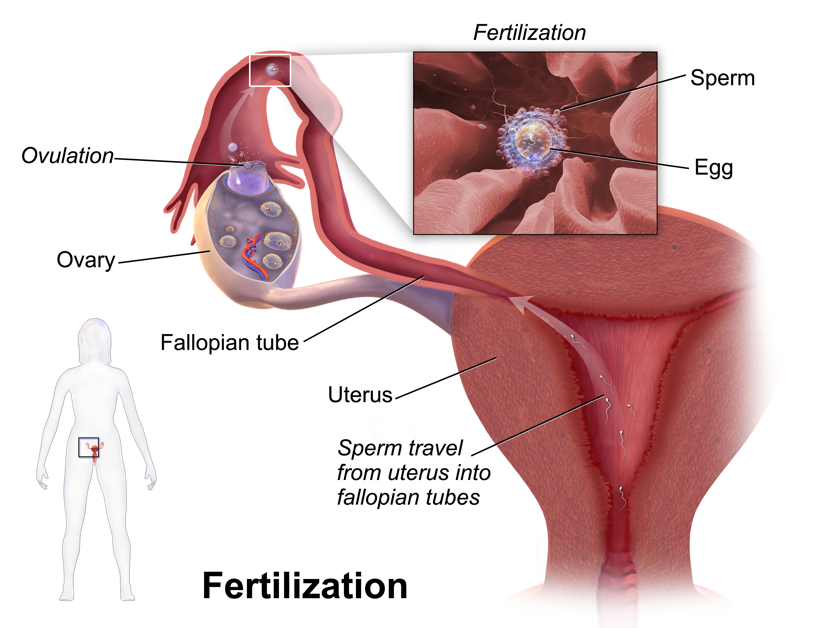
Blausen.com staff (2014). "Medical gallery of Blausen Medical 2014". WikiJournal of Medicine 1 (2). DOI:10.15347/wjm/2014.010. ISSN 2002-4436.
Notes:
If fertilization occurs, the resulting embryo travels back down the fallopian tube into the uterus with the hope that the embryo implants and leads to the birth of a healthy baby

Slide 5

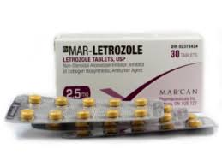
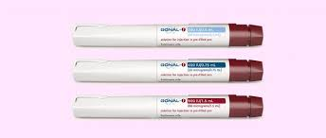
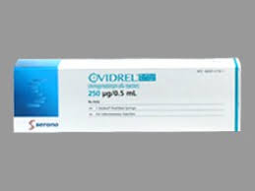
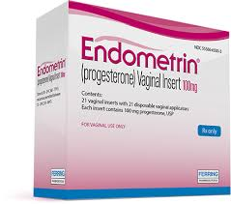
Medications
Notes:
Let’s begin by talking about the medications you may be prescribed in your treatment cycle.
Your doctor may prescribe a pill called letrozole, which you take by mouth for 5 consecutive days, usually beginning on the third day of your cycle.
Or, you may be prescribed injectable medications like Gonal –F, luvaris, menopur or repronex. You will learn how to inject these medications yourself, just under the skin around your belly button. You will give yourself these injections each day to stimulate your ovaries to produce more than one egg follicle. The dose will selected just for you by your doctor.
You may also be prescribed a medication to trigger ovulation, or the release of eggs from the ovary. This medication is called ovidrel or hCG.
Finally, depending on your specific treatment, you may be prescribed progesterone to start taking vaginally 2 days after your insemination procedure This medication is called endometrin or prometrium.

Slide 6
Medication side effects
Letrozole
  Hot flashes, night sweats, headache, mood changes, dizziness or tiredness
  Bloating, pelvic pain or vaginal dryness
  Sometimes, a thinner uterine lining is seen on ultrasound
Injectable medications
  Bloating, fatigue, pelvic pain, injection site reaction
Refrain from intense exercise and the use of ibuprofen
Notes:
The pill Letrozole may cause Hot flashes, night sweats, headache, mood changes, dizziness or tiredness. It can sometimes cause bloating or a pelvic pressure or discomfort. , Some women develop a thin lining of the uterus– if this happens, an alternative medication may be prescribed next cycle if you are not pregnant. If you develop a severe headache or visual disturbance while taking these medications you should stop and contact the clinic.
Injectable medications like gonal F are usually very well tolerated, but can cause include bloating, fatigue, or pelvic tenderness caused by enlarging ovaries, or injection site reactions or pain.
Once you start these stimulation medications, you should refrain from intense exercise and avoid taking ibuprofen You may continue to take Tylenol as needed for discomfort or a headache. You will likely still have your period when you start your stimulation medications.

Slide 7
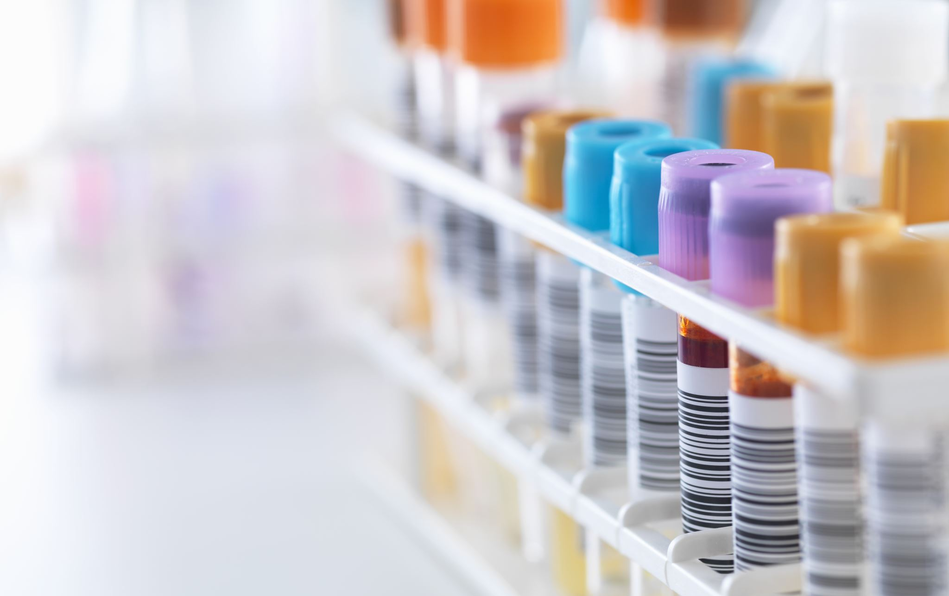


Treatment monitoring
Day 1 = First day of full menstrual flow
Letrozole should be taken for 5 days, beginning on day 3 of your cycle
Injectables start on day 2, 3 or 4 of your cycle
Ultrasound and bloodwork is used to monitor your ovarian response to medication beginning day 7-10 of cycle
Notes:
Your SO/IUI cycle begins with the start of your menstrual period.
Day 1 of your cycle is considered the first day of full menstrual bleeding.
If you doctor has prescribed letrozole, you will begin taking it on the 3rd day of your period. If you have been prescribed injectable medications, you will be instructed to start on day 2, 3 or 4 of your cycle. Most women need 8-12 days before their egg follicles are ready.
The first blood test and ultrasound are usually performed between days 7 and 10 of your cycle.

Slide 8


Monitoring
Notes:
You will be monitored with bloodtests and ultrasound in the second week of your cycle. The purpose is to monitor how many and how big your egg follicles are using ultrasound and corresponding hormone levels.
After your first ultrasound and bloodwork, you will be called back for blood tests and ultrasounds 1, 2 or 3 days later. As the egg follicles grow, you will need testing to see if your body is getting ready to ovulate. This testing can easily be done by using urine ovulation prediction kits, or urine LH kits at home, or by blood work drawn at the hospital.
After each day of monitoring, you will be called by the fertility nurse with your results. Your medication dose might need to be adjusted. The nurse will also check with you to make sure you have enough medication and needles to use until your next appointment.

Slide 9

Ovulation Trigger
Sometimes, women start to ovulate on their own when the egg follicles are ready
Sometimes, medication is needed to trigger ovulation
Depending on the results of your urine test or bloodwork, you will be instructed if Ovidrel® is needed
In general, Ovidrel ® should be taken at 10pm and insemination will occur about 36-40hrs later
Notes:
In some cases, your body will naturally begin the hormone changes that trigger ovulation. Sometimes, you will need to take a different injectable medication to trigger ovulation, called Ovidrel.
Ovulation is the final maturation and release of the eggs from the ovary.
The timing of ovidrel is determined by the physician according to your ultrasound and blood or urine test results.
Our fertility nurse will give you instructions about when to take ovidrel once your blood tests from that morning are available. Usually, she will ask you to take the Ovidrel at 10pm.
Ovidrel takes about 36 hours to work, so your insemination will be scheduled accordingly.
For example, if you take ovidrel on Tuesday night, your insemination will be scheduled for Thursday morning.
Once you take Ovidrel, you do not need to take anymore stimulation medications.

Slide 10
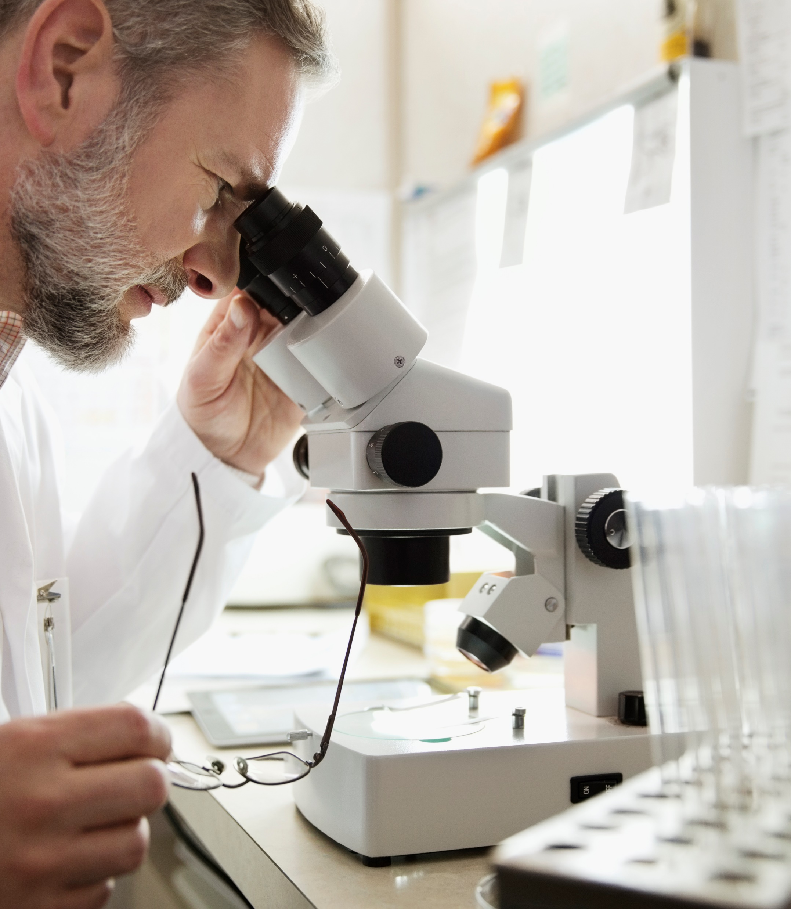
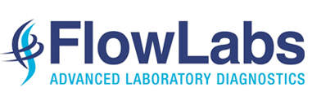
Intrauterine Insemination
If your reproductive partner is the sperm provider, than the semen needs to be produced by masturbation on the morning of insemination
The semen should be kept at body temperature and dropped off at Flowlabs on the 5th floor of KGH within 1 hour of collection
Once the semen is received by Flowlabs, it will be “washed” to separate, concentrate and activate the sperm
Notes:
On the morning of the insemination, if your reproductive partner is the sperm provider, than the semen needs to be produced by masturbation. The semen should be kept at body temperature to avoid it getting too cold or too hot. The semen should be dropped off at Flowlabs on the 5th floor of KGH within 1 hour of collection.
Once the semen is received by Flowlabs, it will be “washed” to separate, concentrate and activate the sperm. This washing process allows the sperm to be placed directly into the uterus, which bypasses the cervical mucus and allows more sperm to move into the uterus and swim up the fallopian tubes.

Slide 11
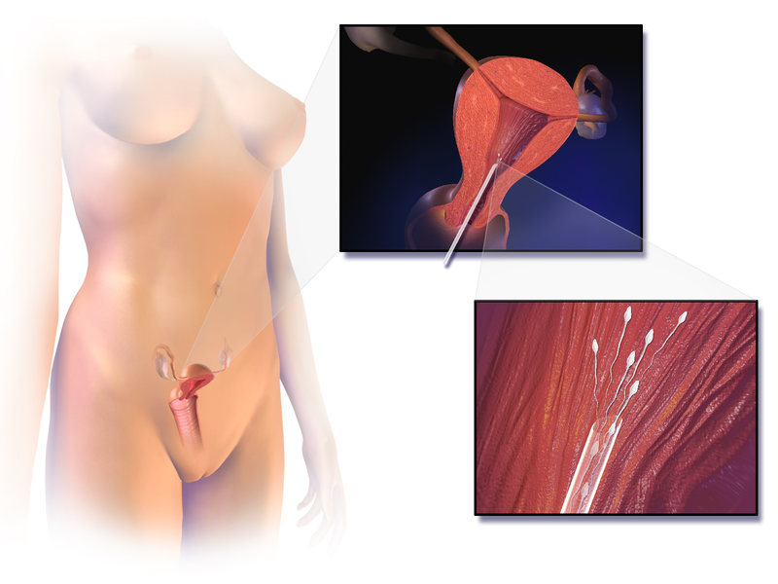
Intrauterine Insemination
Change into gown
Confirm identity
Speculum examination
Placement of small catheter into uterus to deposit sperm
Blausen.com staff (2014). "Medical gallery of Blausen Medical 2014". WikiJournal of Medicine 1 (2). DOI:10.15347/wjm/2014.010. ISSN 2002-4436.
Notes:
You will be given a time to come to the Kingston Reproductive Centre for your insemination. When you arrive, you will be brought into an exam room by a nurse or medical resident and asked to change. The nurse will then retrieve your washed sperm specimen from Flowlabs. If you are using frozen donor sperm, a unit of sperm will be thawed after you have arrived. Before insemination, the nurse will confirm with you the name on the specimen or donor number if applicable. She will then load your specimen into a small sterile tube called a catheter.
A speculum will be placed inside the vagina in order to see your cervix. The catheter will be passed through the cervix into the uterus. You may experience slight discomfort or cramping with the insertion. The specimen will then be slowly injected into the uterus.
Sometimes the cervix is difficult to pass due to an irregular pathway and it can take a few minutes to complete the procedure. You may get a small amount of spotting after the procedure, but this does not affect the success rate.

Slide 12

Next Steps
After insemination, rest for 10-15 minutes
Pregnancy test 2 weeks later
Questions or concerns? Follow up with your doctor
Notes:
After insemination, you will rest for 10-15 minutes and then you can leave and go about your day as you normally would.
Depending on what your doctor has prescribed, you may be asked to take a vaginal progesterone suppository twice a day, called endometrin or prometrium.
2 weeks after your procedure, It is recommended that you do a home pregnancy test, even if you have a period, because sometime bleeding can occur in early pregnancy.
If your pregnancy test is positive, please call the KRC and we will arrange a bloodwork to test your pregnancy hormone level and then an ultrasound about 3 weeks later.
If your pregnancy test is negative, you can call the KRC to start another cycle, or to book a follow up appointment with your doctor to go over things. I recommend always meeting back with you doctor if you are not pregnant after 3 cycles of treatment.
You have now completed the overview for the SO/IUI treatment planned by your physician. The next step is to review some risks associated with SO/IUI.

Slide 13
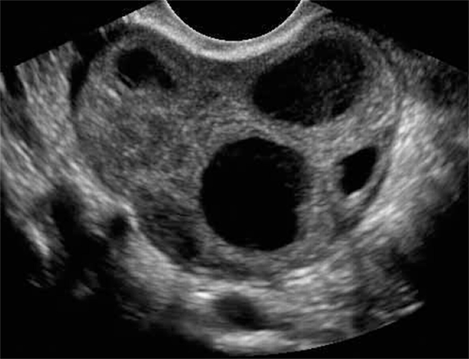
Risks of Superovulation
Twins (8-15%), Triplets (1-3%)
Cycle cancellation for over-stimulation
Risks of Intrauterine Insemination
Pain or bleeding
Infection
Prostaglandin reaction
Blausen.com staff (2014). "Medical gallery of Blausen Medical 2014". WikiJournal of Medicine 1 (2). DOI:10.15347/wjm/2014.010. ISSN 2002-4436.
Notes:
Slide 11
The biggest risk of taking fertility drugs is the risk of a twin or triplet pregnancy. Carrying more than 1 baby at a time increases risks to both mom and babies, including the risk of miscarriage or preterm delivery which can have very serious complications, c-section, heavy bleeding after delivery or other complications in pregnancy like high blood pressure or diabetes. Sometimes, the risk of a twin or triplet pregnancy is too high, and the cycle has to be cancelled.
The risks of intrauterine insemination are low, but include a chance of pain or light bleeding after the procedure, and a very low risk of infection. Rarely, there can be more severe cramping called a prostaglandin reaction. This is treated with pain medications and monitoring until the cramping subsides.

Slide 14
Injectable medication teaching videos
Gonal-F (DIN:02270404)
https://fertility.mymomentum.ca/content/healthcare/biopharma/mymomentum/en_CA/gonalf-pen/resources.html
Ovidrel (DIN 02371588)
https://fertility.mymomentum.ca/content/healthcare/biopharma/mymomentum/en_CA/ovidrel-pen/resources.html
Menopur (DIN 02283093)
https://www.ferringfertility.com/products/menopur/
Endometrin (DIN 02334992)
https://www.ferringfertility.com/products/endometrin/
Notes:
The next step is to visit the links on this slide in order to learn how to give yourself your own injections. These are step-by-step programs that will teach you how to administer your injections. Once you are comfortable with your injections you are ready to call with your next day 1. If you do not feel comfortable giving your injections after using the online tool, please call the nurses to discuss further.
We cannot always accommodate every patient during their next cycle for reasons of patient safety and lab considerations. We will however always do our best to ensure that you are treated in a timely manner.

Slide 15
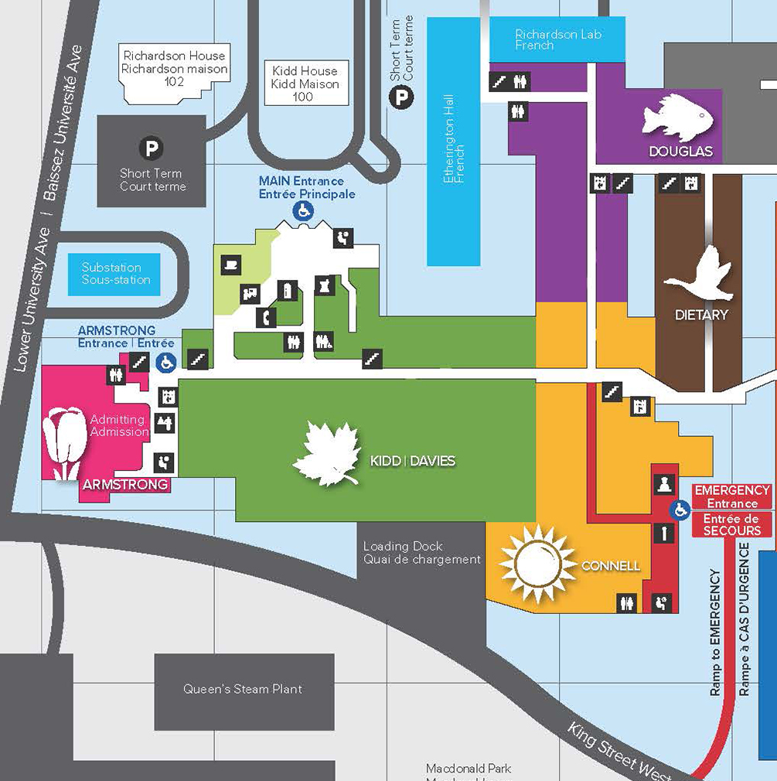
KRC Hours
Monday- Friday:
7am-3pm
Weekends and Holidays: Monitoring and inseminations are still performed
KRC
Pharmacies with fertility medications in stock
Clinic Pharmacy
Main Lobby KGH
Medical Arts Pharmcy
800 Princess St
Notes:
Here at the Kingston Reproductive Centre, our goal is to provide you with all the services necessary for a successful SO/IUI treatment cycle right here at KGH. Undergoing fertility treatment can be overwhelming and we hope to relieve some anxiety by making this process easier for you.
The Kingston Reproductive Centre is located on the 5th floor of the Kidd wing of the hospital and is open from 7am-3pm Monday to Friday but monitoring and inseminations do take place on weekends and holidays as well.
You can choose which pharmacy you would like to use to dispense your medications. However, the Clinic Pharmacy in the lobby of KGH carries these medications in stock. Clinic Pharmacy is closed on weekends, but Medical Arts Pharmacy at 800 Princess St always keeps fertility medications in stock as well.

Slide 16

Contact Information for the
Kingston Reproductive Centre
613-548-1353
If leaving a message, be sure to:
  Speak clearly
  Leave first and last name
  Leave your phone number so we can call you back

Slide 17
Thank you!
Kingston Reproductive Centre
Virtual Teaching Visit
Notes:
Welcome to the patient education session on superovulation and intrauterine insemination at the Kingston Reproductive Centre at Kingston General Hospital. My name is Dr. Bryden Magee and I am one of the reproductive endocrinologist and infertility specialists at the KRC.

